Slide 1

Task03-04
David Gaupp, Miletic Marko, Selvasingham Sugeelan, Velkov Viktor, Janahan Sellathurai, Alain Nippel

Slide 2
Task03: Software Architecture
UML – Deployment Diagram
UML – Component Diagram
UML – Class Diagram for main view

Slide 3
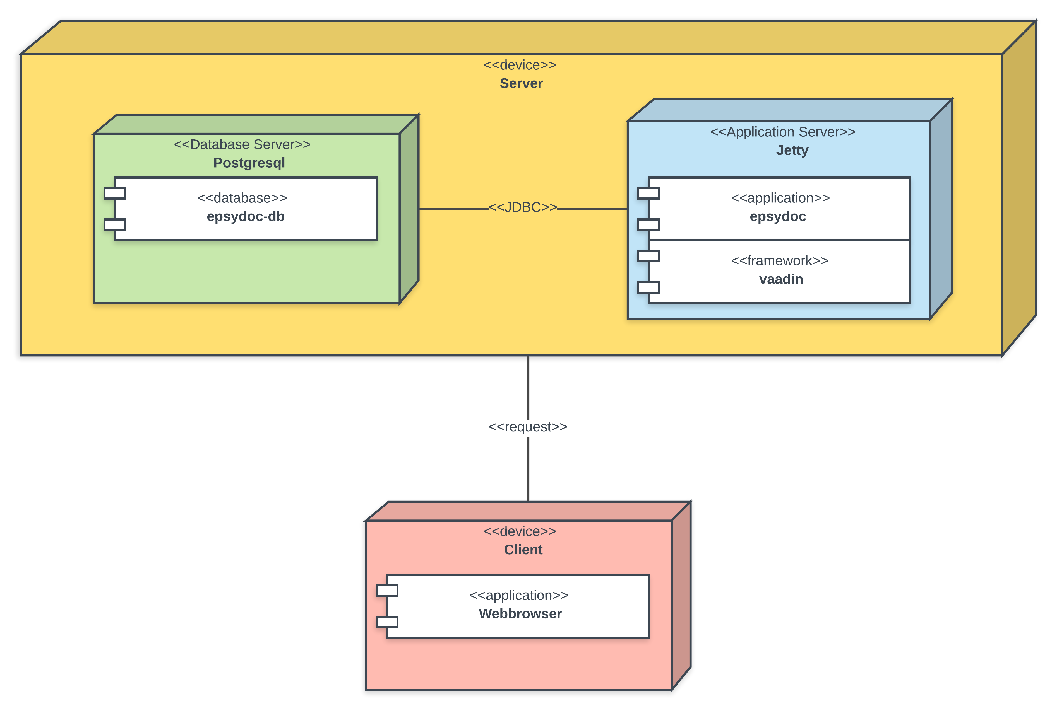
UML – Deployment Diagram

Slide 4
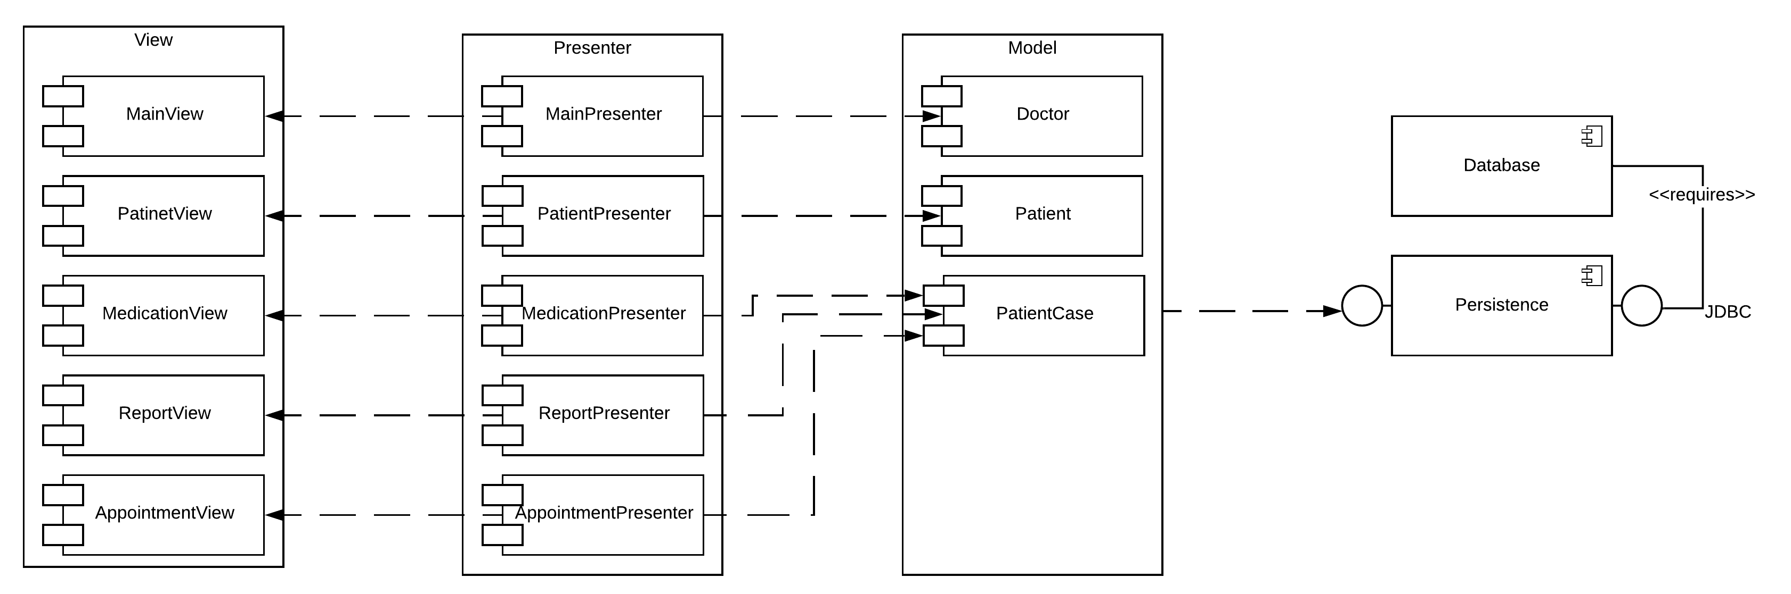
UML – Component Diagram

Slide 5
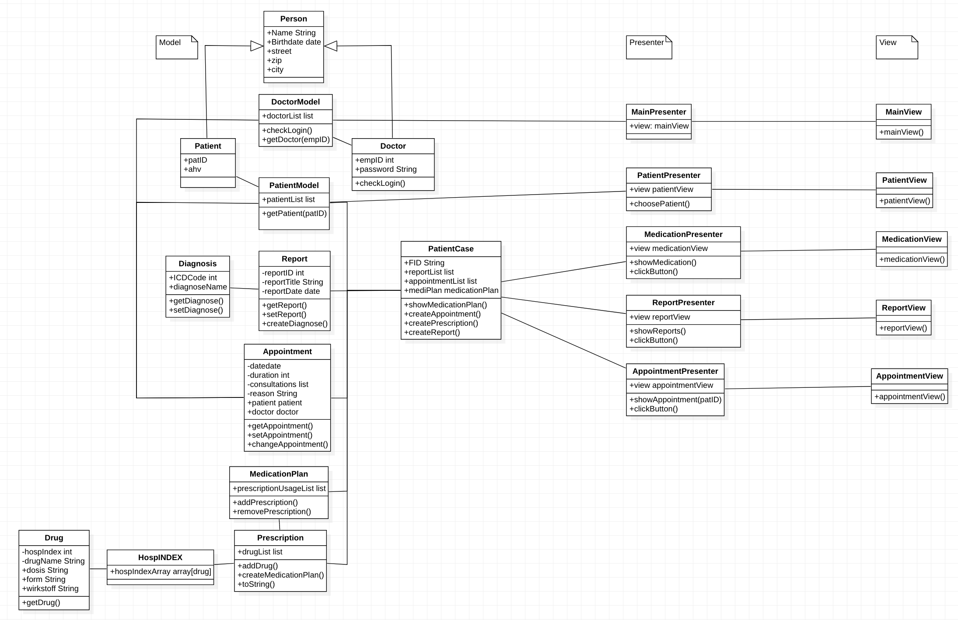
UML – Class Diagram for main view

Slide 6
Task04: Scrum Setup
General
Product Backlog
Sprint Backlog

Slide 7

General

Slide 8
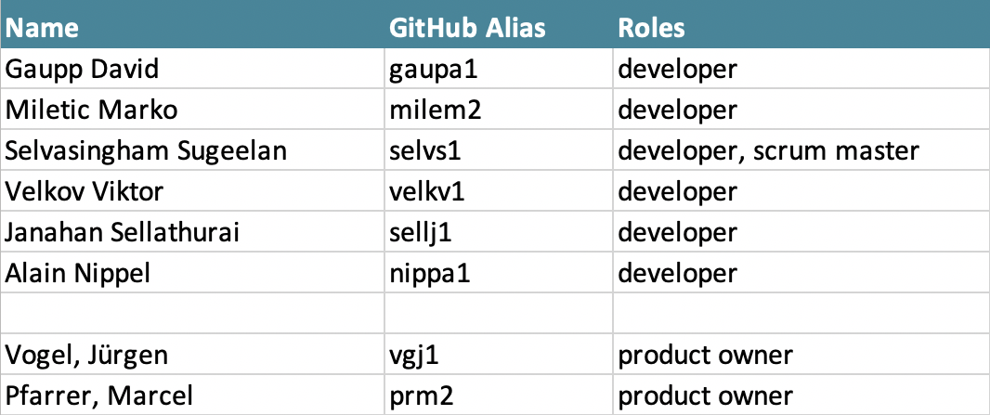
Scrum - Roles

Slide 9
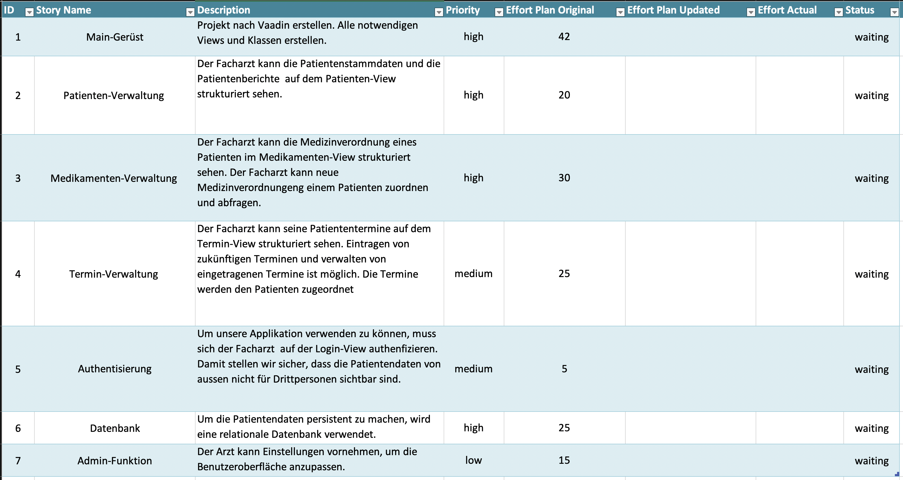
Product backlog

Slide 10
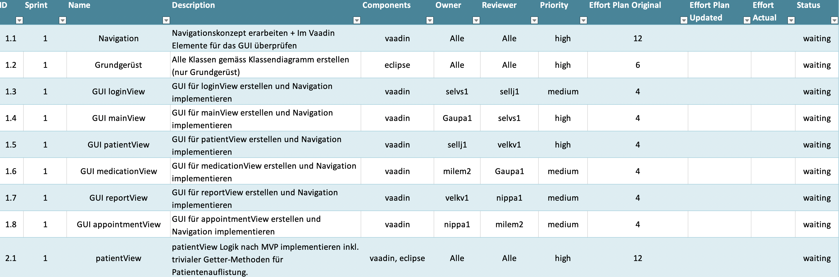
Sprint backlog

Slide 11

Vielen Dank für eure Aufmerksamkeit
Noch Fragen?

Slide 12
Bilderquellen
Titelbild: https://image.jimcdn.com/app/cms/image/transf/dimension=697x10000:format=jpg/path/sd47613ceb1db53f4/image/ib674891e8fb5286a/version/1515513892/patientenzimmer-untersuchungszimmer-praxis-hausarzt-friedeck-rothenburg.jpg

